Slide 1

AI Job Market Insights
RAHUL YELANE
© All rights reserved by Fireblaze Technologies Pvt. Ltd.

Slide 2
Problem Statement
In today’s rapidly evolving technological landscape, Artificial Intelligence (AI) is reshaping industries and job markets worldwide. However, stakeholders, such as job seekers, businesses, and policymakers, often struggle to understand the specific trends in AI job growth. There is a need for accurate data-driven insights to identify which AI-related skills and roles are in demand, forecast future job growth, and make informed decisions.
© All rights reserved by Fireblaze Technologies Pvt. Ltd.

Slide 3
Proposed Solution
To address this challenge, I developed an AI Job Market Insights dashboard. Using a combination of data cleaning in Excel, Data visualization in Power BI, and machine learning (ML) modeling, this solution offers comprehensive insights into the current AI job market.
© All rights reserved by Fireblaze Technologies Pvt. Ltd.

Slide 4
Descriptive Analysis
Key features include:
Data Visualization: An interactive dashboard in Power BI that visualizes AI job trends, in-demand skills, and geographical distribution of opportunities.
Job Growth Projection: A machine learning model designed to predict job growth trends within the AI sector, helping users identify future opportunities and make strategic decisions.
Actionable Insights: The dashboard highlights growth opportunities, skills in demand, and projections for emerging AI roles, empowering businesses, job seekers, and policymakers to stay ahead in the AI job market.
© All rights reserved by Fireblaze Technologies Pvt. Ltd.

Slide 5
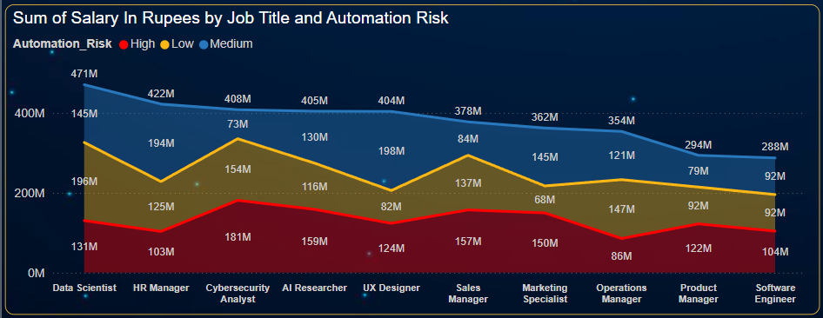
Descriptive Analysis
Highest Automation Risk:
Cybersecurity analysts face
the highest risk of automation.
Medium Automation Risk:
Roles including HR Manager,
Marketing Specialist, and
UI/UX Designers are in the
medium-risk category.
Lowest Automation Risk:
Data Scientist roles have
the lowest risk of automation.
Data Scientist Thriving:
Data Scientist roles are thriving across highest salaries, showcasing strong demand and adaptability.
© All rights reserved by Fireblaze Technologies Pvt. Ltd.

Slide 6
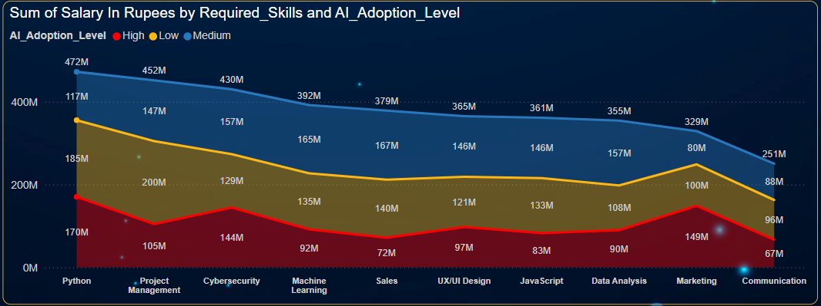
Descriptive Analysis
Highest AI Adoption Level:
Python, cybersecurity,
and marketing have the
highest AI adoption, driven
by automation and innovation.
Medium AI Adoption Level:
Machine learning, sales,
data analysis, and project
management show medium
AI adoption.
Lowest AI Adoption Level:
Project management
have the lowest AI adoption, despite Python's key role in AI development.
Python Programming Thriving:
Python skill offers the highest salary across these fields.
© All rights reserved by Fireblaze Technologies Pvt. Ltd.

Slide 7
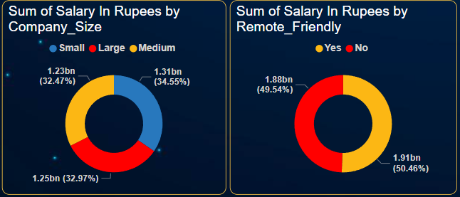
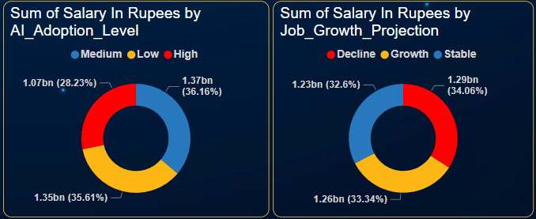
Descriptive Analysis
Company Size Distribution:
Almost the same distribution across
different company sizes.
Remote-Friendly Distribution:
Almost the same distribution, likely
Influenced by post-COVID work culture
changes.
AI Adoption Level:
Medium and Low AI Adoption Levels:
Almost the same distribution.
High AI Adoption Level:
The lowest distribution.
Job Growth Projection:
Almost the same distribution in terms
of Job growth projection across Salary.
© All rights reserved by Fireblaze Technologies Pvt. Ltd.

Slide 8
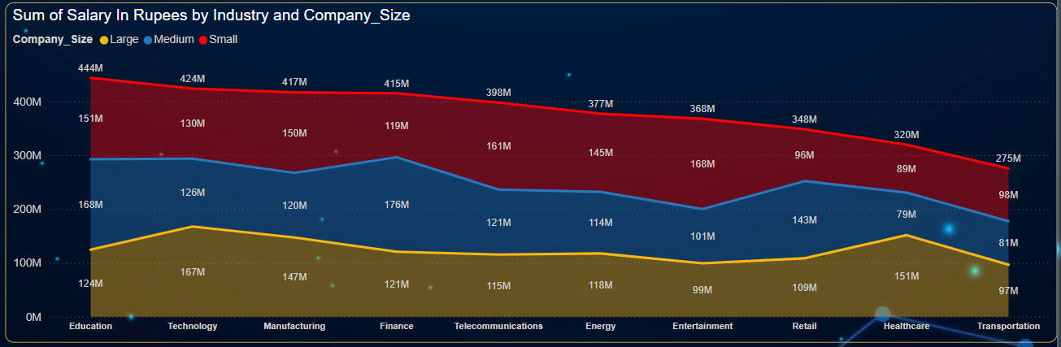
Descriptive Analysis
Largest Company Size:
Technology, Healthcare,
Manufacturing are the largest
industries by company size,
driven by innovation and
large-scale demand.
Medium Company Size:
Finance, Education, Retail fall
under medium company size,
with steady but smaller growth
compared to larger industries.
Small Company Size:
Entertainment, Telecommunication are in the small company size category due to niche markets and competitive environments.
Education industry generates the highest revenue, fueled by the growth of online learning and educational technologies.
© All rights reserved by Fireblaze Technologies Pvt. Ltd.

Slide 9
Effect of Data Preprocessing
Encoding: Converting categorical data into numerical format, e.g., Label Encoding
Outlier Detection: Identifying and handling outliers to prevent skewing of results.
Statistical Summary: Review descriptive statistics to understand the central tendency, dispersion (SD, skewness, etc), and shape of the data distribution.
© All rights reserved by Fireblaze Technologies Pvt. Ltd.

Slide 10
Machine Learning Modelling
Random Forest Classifier uses ensemble methods to improve accuracy, but in this case, it did not perform optimally.
Performance score: 40%
Gradient Boosting Classifier iteratively reduces errors but achieved similar performance to other models.
Performance score: 40%
Decision Tree Classifier makes decisions based on tree-like structures but had the lowest performance among the models.
Performance score: 38%
© All rights reserved by Fireblaze Technologies Pvt. Ltd.

Slide 11
Machine Learning Modelling
AdaBoost Classifier boosts weak learners to achieve better performance, though it remained at par with other models.
Performance score: 40%
K-Neighbors Classifier classifies based on the nearest neighbors but did not outperform other models.
Performance score: 40%
© All rights reserved by Fireblaze Technologies Pvt. Ltd.

Slide 12
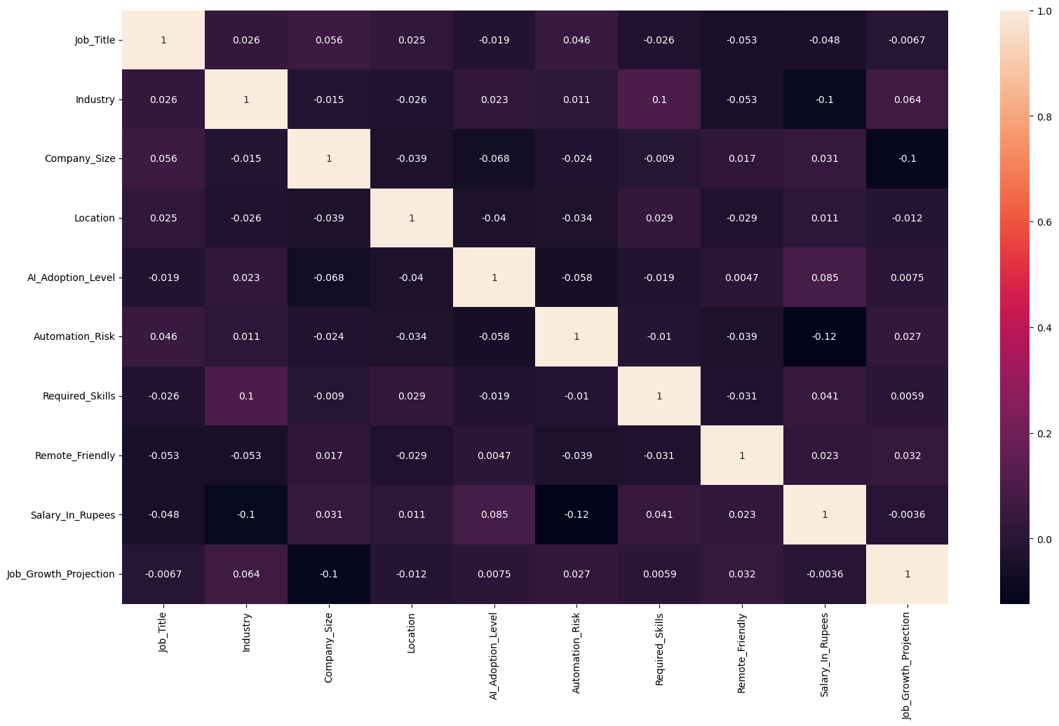
Optimisation
Small Dataset Size:
A limited dataset might not provide enough examples for the models to learn from, leading to overfitting or underfitting. (10 columns and only 500 rows)
Low Feature Co-linearity:
Low co-linearity between input features may reduce the models' ability to detect strong relationships between variables, limiting their predictive power.
© All rights reserved by Fireblaze Technologies Pvt. Ltd.

Slide 13
Conclusion
The AI Job Market Insights dashboard provides valuable, data-driven insights into AI job growth, skill demand, and automation risks. Despite the evolving technological landscape, key findings suggest that cybersecurity faces the highest automation risk, while data scientists enjoy the lowest. AI adoption trends reveal Python and marketing are at the forefront of automation, though challenges remain in job growth prediction due to limitations in model performance.
Machine learning models like Random Forest, Gradient Boosting, and AdaBoost showed consistent but low performance scores (40%), which may be attributed to small dataset size and low feature co-linearity. Despite these challenges, the dashboard successfully offers a comprehensive view of AI job trends, supporting better decision-making for job seekers, businesses, and policymakers.
The education industry emerged as a key player, outperforming other sectors in revenue generation, while technology, healthcare, and manufacturing are thriving in terms of company size.
© All rights reserved by Fireblaze Technologies Pvt. Ltd.

Slide 14
Future Scope
Improving Model Performance:
Increase the dataset size to enhance machine learning models’ ability to detect complex patterns.
Feature engineering (EDA) and collinearity analysis can be further explored to improve predictive power.
Refinement of Insights:
Expand the dataset to include more granular job roles, regions, and industries to provide deeper insights.
Incorporate real-time data for more accurate and up-to-date AI job market trends and forecasts.
Targeting Niche Industries:
Provide more detailed analysis on small industries like entertainment and telecommunications, where AI adoption and automation risks are still developing.
Addressing Automation Risks:
Develop strategies to mitigate the high automation risk roles like cybersecurity by focusing on human oversight and advanced skill development.
© All rights reserved by Fireblaze Technologies Pvt. Ltd.

